Slide 1


DCO Operational Readiness
NetApp ® FlexClone ® Capabilities for Partial or Full
Oracle Database Recoveries

Slide 2
OR Project team
Storage – David Ellis, Craig Goettig
Oracle DBA – Ramkumar Janardanan, Devjeet Mukherjee
(contribution from Mike Brunette)
Charles Uchidiuno – DCO OR (Oracle Database and Middleware)

Slide 3
Agenda
High Level Overview of NetApp FlexClone
Process overview
Prerequisites
OR Factory screenshots
Q & A

Slide 4
High Level Overview of NetApp FlexClone
What is FlexClone?
FlexClone technology creates exact, virtual copies of data volumes, files, and LUNs without additional storage space. NetApp® FlexClone® technology instantly replicates data volumes and datasets as transparent, virtual copies—true clones—without compromising performance or demanding additional storage space.
Source: http://www.netapp.com/us/products/platform-os/flexclone.aspx

Slide 5
Agenda
High Level Overview of NetApp FlexClone
Process overview
Prerequisites
OR Factory screenshots
Q & A

Slide 6
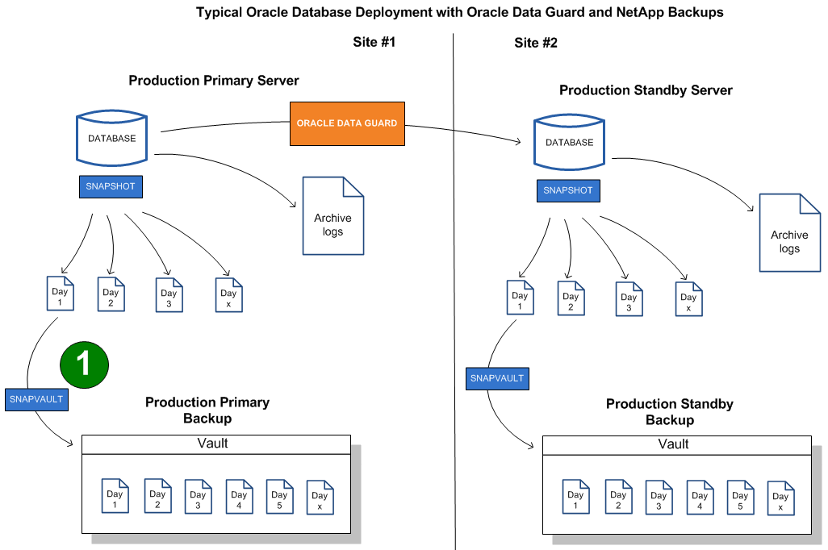
Process overview

Slide 7
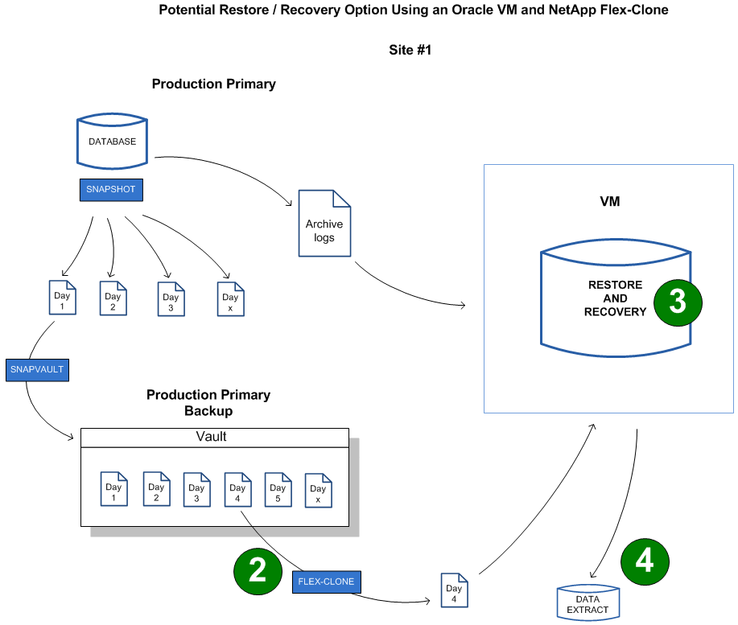
Process overview - continued

Slide 8
Agenda
High Level Overview of NetApp FlexClone
Process overview
Prerequisites
OR Factory screenshots
Q & A

Slide 9
Prerequisites
Storage prerequisites
- create “nfsclone” user on the backup filer
- create oracle user and standard SSH key used for snapshots and snapvaults
Oracle DBA prerequisites
- Need a restore VM (LION virtual server 4 CPU x 24GB)
- 100 to 500GB of nosnap NAS for miscellaneous Oracle directories (i.e. /n01/oradata1, /n01/oraadmin1, /n01/oraarch1, /n01/oraarch2 and /n01/exports)
- nfsclone utility (nfsclone.pl and nfsclone should be in /dba/bin)
- verify restore VM script /tools/dba/oracle/linux_64/flexclone/verify_11203_restore_vm

Slide 10
Agenda
High Level Overview of NetApp FlexClone
Process overview
Prerequisites
OR Factory screenshots
Q & A

Slide 11
OR Factory screenshots
On primary database cluster:
orf-moose-12 {/home/oracle}: olsnodes -n
orf-moose-12 1
orf-whitetail-13 2
orf-moose-12 {/home/oracle}:
Restore VM:
orf-ofc-1 {/home/oracle}: uname -n
orf-ofc-1
orf-ofc-1 {/home/oracle}:
Excerpt from routine snapshot backups
** Check lag to Backup Filer
Running command: ssh eag-nasor-fs04 -i ~/.ssh/nssdba.snapvault snapvault status /vol/orf_labwork3t_s01ora1_snap
Snapvault is ON.
Source Destination State Lag Status
eag-nasor-fs04:/vol/orf_labwork3t_s01ora1_snap eag-nasor-bkp02:/vol/sv_14_orf_labwork3t_s01ora1_snap/1 Source 12:00:00 Idle

Slide 12
OR Factory demonstration (cont’d)
orf-moose-12 {/home/oracle}: ssh eag-nasor-bkp02 -i ~/.ssh/nssdba.snapvault snap list sv_14_orf_labwork3t_s01ora1_snap
Volume sv_14_orf_labwork3t_s01ora1_snap
working...
%/used %/total date name
---------- ---------- ------------ --------
0% ( 0%) 0% ( 0%) Jun 24 08:05 sv_orf_labwork3t_s01ora1_snap_s01oradata1.0
0% ( 0%) 0% ( 0%) Jun 24 08:05 eag-nasor-bkp02(1787972560)_sv_14_orf_labwork3t_s01ora1_snap-base.0 (busy,snapvault)
1% ( 1%) 0% ( 0%) Jun 23 08:05 sv_orf_labwork3t_s01ora1_snap_s01oradata1.1
1% ( 0%) 0% ( 0%) Jun 22 08:05 sv_orf_labwork3t_s01ora1_snap_s01oradata1.2
2% ( 1%) 0% ( 0%) Jun 21 08:05 sv_orf_labwork3t_s01ora1_snap_s01oradata1.3
3% ( 1%) 0% ( 0%) Jun 20 08:05 sv_orf_labwork3t_s01ora1_snap_s01oradata1.4
3% ( 0%) 0% ( 0%) Jun 19 08:05 sv_orf_labwork3t_s01ora1_snap_s01oradata1.5
4% ( 1%) 1% ( 0%) Jun 18 08:05 sv_orf_labwork3t_s01ora1_snap_s01oradata1.6
5% ( 1%) 1% ( 0%) Jun 17 08:05 sv_orf_labwork3t_s01ora1_snap_s01oradata1.7
5% ( 1%) 1% ( 0%) Jun 16 08:05 sv_orf_labwork3t_s01ora1_snap_s01oradata1.8
6% ( 1%) 1% ( 0%) Jun 15 08:05 sv_orf_labwork3t_s01ora1_snap_s01oradata1.9
7% ( 1%) 1% ( 0%) Jun 14 08:05 sv_orf_labwork3t_s01ora1_snap_s01oradata1.10
7% ( 0%) 1% ( 0%) Jun 13 08:05 sv_orf_labwork3t_s01ora1_snap_s01oradata1.11
8% ( 1%) 1% ( 0%) Jun 12 08:05 sv_orf_labwork3t_s01ora1_snap_s01oradata1.12
8% ( 1%) 1% ( 0%) Jun 11 08:05 sv_orf_labwork3t_s01ora1_snap_s01oradata1.13
orf-moose-12 {/home/oracle}:

Slide 13
OR Factory screenshots (cont’d)
orf-ofc-1 {/home/oracle}: sudo /dba/bin/nfsclone -o connect -h eag-nasor-bkp02 -u nfsclone -m /s01/oradata1 -p /vol/sv_14_orf_labwork3t_s01ora1_snap/1 -s "sv_orf_labwork3t_s01ora1_snap_s01oradata1.1"
Enter password for nfsclone@eag-nasor-bkp02:
Mon Jun 24 16:51:42 2013: Checking connectivity for nfsclone@eag-nasor-bkp02.
Mon Jun 24 16:51:42 2013: Connectivity OK - NetApp Release 8.1RC2 7-Mode: Thu Oct 27 19:26:06 PDT 2011 Multistore.
Mon Jun 24 16:51:42 2013: Checking storage system configuration.
orf-ofc-1 {/home/oracle}:

Slide 14
OR Factory screenshots (cont’d)
orf-ofc-1 {/home/oracle}: df -h
Filesystem Size Used Avail Use% Mounted on
/dev/mapper/rootvg-rootlv
12G 1.4G 9.9G 13% /
tmpfs 12G 0 12G 0% /dev/shm
/dev/sda1 485M 80M 380M 18% /boot
/dev/mapper/rootvg-homelv
2.0G 69M 1.9G 4% /home
/dev/mapper/rootvg-perflv
485M 161M 299M 35% /perf
/dev/mapper/rootvg-tmplv
1008M 40M 918M 5% /tmp
/dev/mapper/rootvg-varlv
4.0G 274M 3.5G 8% /var
/dev/mapper/datavg-u01lv
40G 5.3G 33G 15% /u01
/dev/mapper/datavg-dbalv
485M 15M 446M 4% /dba
eag-nasor-fs04:/vol/orf_ofc_no1ora1_nosnap/no1ora1
500G 47G 454G 10% /n01
eag-nasor-bkp02:/vol/sv_14_orf_labwork3t_s01ora1_snap_clone_1372110702/1
200G 34G 167G 17% /s01/oradata1
orf-ofc-1 {/home/oracle}:

Slide 15
OR Factory screenshots (cont’d)
Live demonstration of restore process

Slide 16
Questions

